Slide 1
Blocking brute force attacks using binomial ladder filter in .net applications

Slide 2
Introduction
In this research project I am going to develop application package to prevent these brute force attacks. This will be a plugin/add-on and can use with any .NET web based applications.

Slide 3
What is Brute Force Attack
A Brute Force attack is a method or an algorithm to determine a password or user name using an automatic process that the Brute Force attack can take depending on your password length and its complexity.

Slide 4
What is Brute Force Attack
The main problem that occurs with a Brute Force attack is stealing important information and server memory problems because the hackers attempt many times to access your account through which many HTTP requests are generated at your server so the result of this is your server goes slow and there is unnecessary traffic at our site.

Slide 5
What is Brute Force Attack
Hackers use many tools for Brute Force attacks. Using those tools there is an algorithms to guess the password automatically or create the combination depending on the given length.

Slide 6
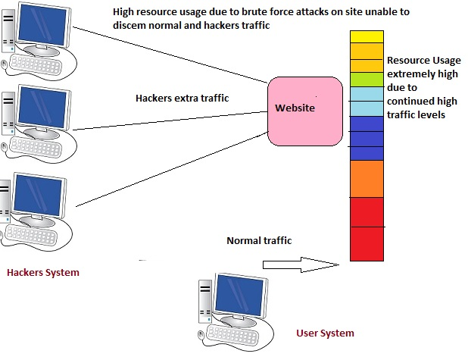
How Brute Force Attacks Work

Slide 7
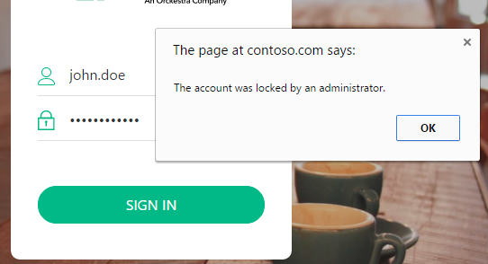
Existing methodology to prevent Brut Force Attack
Locking Account A very famous and popular trick to prevent a Brute Force Attack is to lock the account. Locking the account means that if a user attempts a wrong password many times then the user's account will be blocked for a given time of period. The locking of the account might be for 2 hours, one day or more.

Slide 8
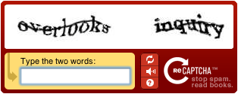
Existing methodology to prevent Brut Force Attack
CAPTCHAs Code Use If a attacker hits your account automatically using auto-generated combinations, then a CAPTCHA code is very useful to prevent this. A CAPTCHA code is a technique by which we recognize a computer or a human.

Slide 9
Space for Improvement
Attackers can pick a common password and try to login to the user's account with that password. If services don't do anything to stop this attack, attackers can issue millions of guesses and compromise many accounts. Some services block user accounts after a few failed guesses, but if attackers are trying to login to all user accounts this will cause all users to be locked out.

Slide 10
Space for Improvement
This is a implementation of an IP reputation framework. It provides two unique features not present in previous system. First, this identifies frequently-occurring passwords in failed login attempts to identify which passwords are being frequently guessed by attackers. To detect frequently-occurring incorrect passwords, it uses a new data structure called a binomial ladder filter.

Slide 11
What is About binomial ladder filter
Binomial filters are simple and efficient structures based on the binomial coefficients for implementing Gaussian filtering. They do not require multipliers and can therefore be implemented efficiently in programmable hardware.

Slide 12
Motivation
Handling a security is a huge responsibility of protecting sensible data and work with a project that make other developers life easier is challenging. Unlike in normal way of protection, the theories and methodologies are not clear cut, and therefore system needs to follow varies technologies to identify the things to protect.

Slide 13
Aim
The aim of this project is to design and develop a Add-on/plugin to assist the other .net based applications to protect from brute force attacks.

Slide 14
Scope
Special design to identify brute force attacks and block those from accessing the application. This will not effect to original users and they can work with out locking or entering captcha code to their accounts.

Slide 15
Academic Objectives
Prepare and submit the Terms of Reference document including aims, objectives, scope and timeline
Carryout literature survey on
existing Methodologies use for protect from attacks
Suitable filtering techniques used for identifying attacks
Identifying dictionary based prediction methodologies
Understand frameworks that is used for handing login functionality
Gather and analyze new requirement of the security measurement
Select and learn tools and technologies which will be used for implementation of the prototype.

Slide 16
Resource Requirements
Software Requirements
.Net framework 4+ application development environment
Visual studio 2015
Microsoft Visio
Microsoft office word/power point
Hardware Requirement
Windows Laptop/Desktop
Internet connection

Slide 17
Project deliverables
Functional artefact
A working model of the proposed Add-on/plugin will be available for demonstration, evaluation and future enhancements.
Simulator for testing add one
Sample application
Documentation
Project proposal
interim project report
draft project report
Final project report consisting of literature survey, design, UML diagrams.
Knowledge
Knowledge gained by performing the research.

Slide 18
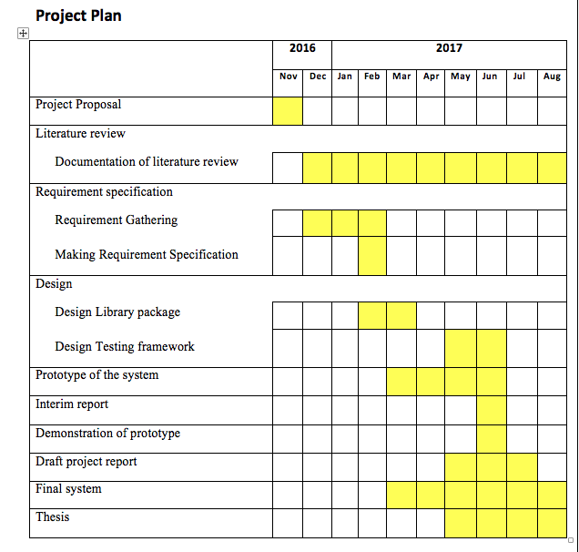
Project Plan

Slide 19
References
References
Lars R. Knudsen, Matthew J. B. Robshaw series 2016 “Information Security and Cryptography”
Marc Cameron 2015 “Brute Force (Jericho Quinn Thriller Book 6) “
Matt Curtin 2005 “Cracking the Data Encryption Standard”
Other Information Sources
Wikipedia about brute force attacks - https://en.wikipedia.org/wiki/Brute-force_attack
Wikibooks Cryptography>Brute_force_attack - https://en.wikibooks.org/wiki/Cryptography/Brute_force_attack

